Slide 1
Optimization Methods Lab 1 Session
12112218 史纪茂

Slide 2
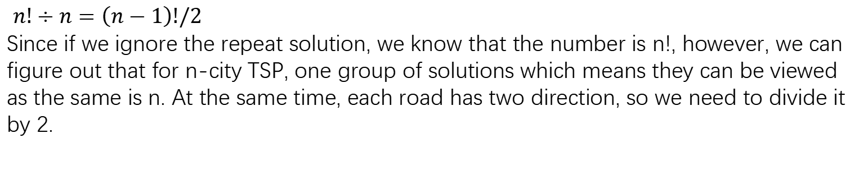
question1
$n!÷n=\left(n−1\right)!/2$
Since if we ignore the repeat solution, we know that the number is n!, however, we can figure out that for n-city TSP, one group of solutions which means they can be viewed as the same is n. At the same time, each road has two direction, so we need to divide it by 2.

Slide 3
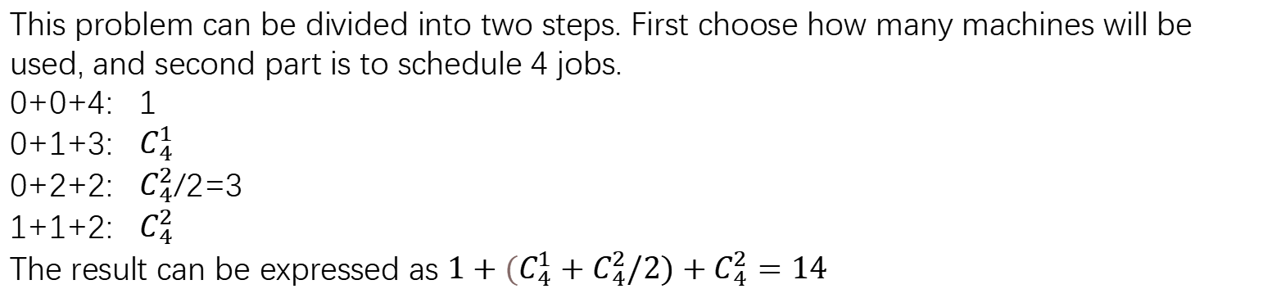
question2
This problem can be divided into two steps. First choose how many machines will be used, and second part is to schedule 4 jobs.
0+0+4: 1
0+1+3: $C_{4}^{1}$
0+2+2: $C_{4}^{2}$/2=3
1+1+2: $C_{4}^{2}$
The result can be expressed as $1+{(C}_{4}^{1}+C_{4}^{2}/2)+C_{4}^{2}=14$

Slide 4
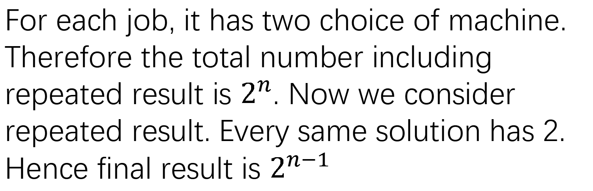
question3
For each job, it has two choice of machine. Therefore the total number including repeated result is $2^{n}$. Now we consider repeated result. Every same solution has 2. Hence final result is $2^{n−1}$

Slide 5
question4
Each items has two choice, whether is chosen or not. For n items, the total number of choice is $2^{n}$, since n = 30, therefore the result is $2^{30}$.

Slide 6
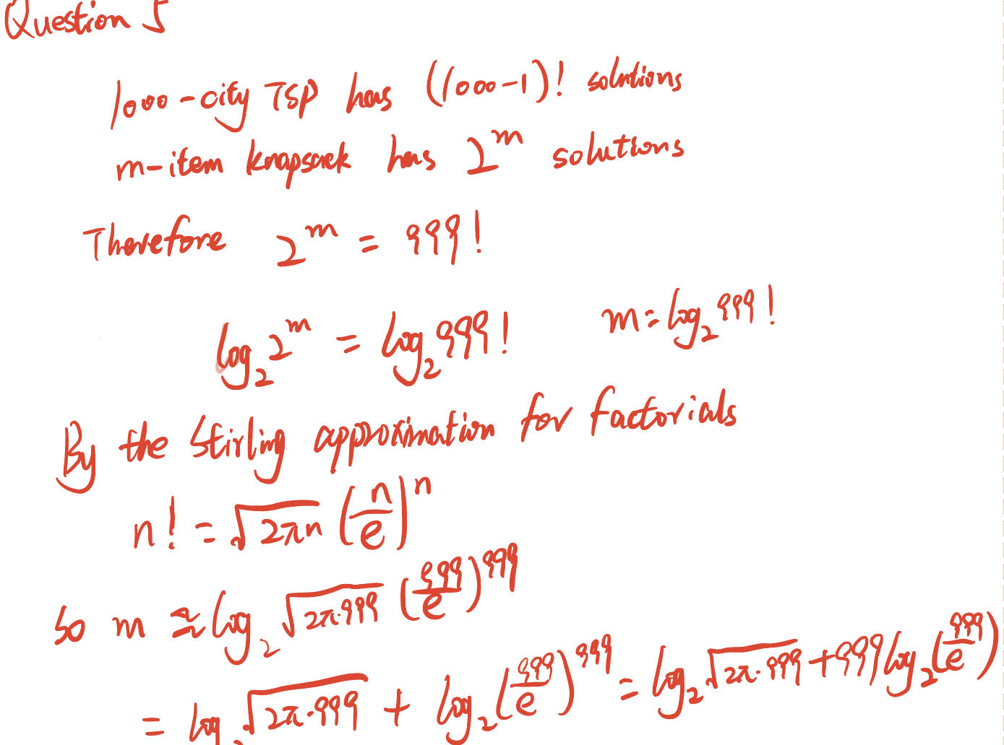


Slide 7
